Slide 1
PROJECT TITLE
CAPSTONE PROJECT
Presented By:
J.Harish-Karpaga Vinayaga College Of Engineering And Technology-B.Tech /Bio Technology

Slide 2
OUTLINE
Problem Statement
Proposed System/Solution
System Development Approach
Algorithm & Deployment
Result
Conclusion
Future Scope
References

Slide 3
Problem Statement
The problem statement for this task is to develop a binary sentiment classification model to predict whether movie reviews are positive or negative based on their text content. The dataset consists of 25,000 highly polar movie reviews for training and another 25,000 for testing. The goal is to build a robust model that can accurately classify reviews into positive and negative categories. The model should be trained using classification or deep learning algorithms and evaluated based on performance metrics such as accuracy, precision, recall, and F1-score.

Slide 4
Proposed Solution
Data Preprocessing: . Tokenize and convert movie reviews into numerical representations.
2. Model:
Create a deep learning model with embedding layer, pooling, dense layers, and output layer
3. Training:
Train the model on 25,000 labeled movie reviews
.4. Evaluation:
Assess the model's performance on another set of 25,000 reviews.
5. Prediction:
Use the trained model to predict sentiment (positive/negative) in real-world scenarios.

Slide 5
System Approach
Problem Definition: Binary sentiment classification of movie reviews.
Data Acquisition: Obtain 25,000 labeled movie reviews for training and testing.
Data Preprocessing: Tokenize, convert to numerical representations, and split into training/testing sets.
Model Selection: Choose a deep learning model suitable for text classification
Model Development: Implement the chosen model architecture using TensorFlow/PyTorch.
Model Training: Train the model on the training dataset, monitoring for overfitting.
Model Evaluation: Assess model performance using metrics like accuracy, precision, recall, and F1-score
Deployment: Deploy the trained model into a production environment for real-world use.
Monitoring and Maintenance: Regularly monitor and update the deployed system to ensure continued performance and reliability.

Slide 6
Algorithm & Deployment
1. Serialize Model: Save your trained model using `model.save()` in TensorFlow/Keras. 2. Choose Deployment Platform:Decide whether to deploy on the cloud or on edge devices. 3. Cloud Deployment: - Choose a cloud service provider like GCP, AWS, or Azure. - Create a virtual machine or container (e.g., Docker). - Deploy your model on the chosen platform using their respective deployment services (e.g., Google Cloud AI Platform, AWS SageMaker). 4. Edge Deployment: - Use frameworks like TensorFlow Lite or TensorFlow.js for deployment on edge devices. - Integrate your model into your application for mobile or web deployment. 5. Create Interface: Develop an interface for users to interact with your model, such as a web app, mobile app, or API. 6. Monitoring and Maintenance: Regularly monitor your deployed model’s performance and update as needed. 7. Compliance:Ensure compliance with legal and regulatory requirements regarding data privacy and security.
Program:
import numpy as n
import pandas as p
import matplotlib.pyplot as m
import seaborn as s
data=p.read_csv("C:\\mydata.csv")
data.head(50)
data.columns
data.tail(50)
data.describe()
s.histplot(data["sentiment"],bins=30,kde=True)
m.title("Histogram")
m.xlabel("reviews")
m.ylabel("sentiment")
m.show()
data["sentiment"].value_counts().plot(kind='bar')
m.title("Bardiagram")
m.xlabel("Reviews")
m.ylabel("Sentiment")
m.show()
m.pie(data["sentiment"].value_counts(),labels=data["sentiment"].unique(),autopct="%.1f%%")
m.title("Piechart")
m.xlabel("Reviews")
m.ylabel("Sentiment")
m.show()

Slide 7
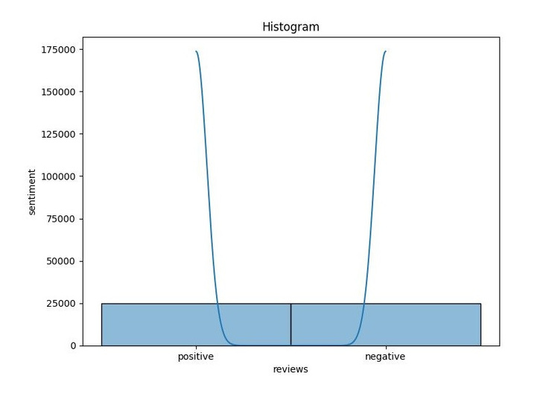
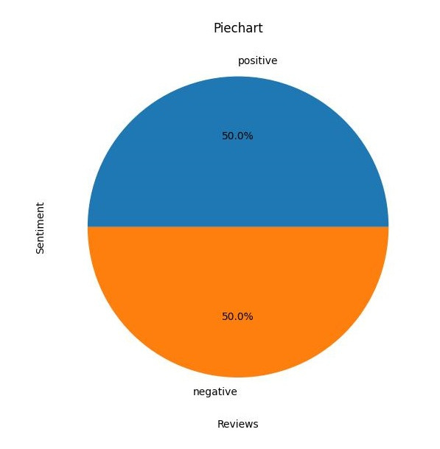
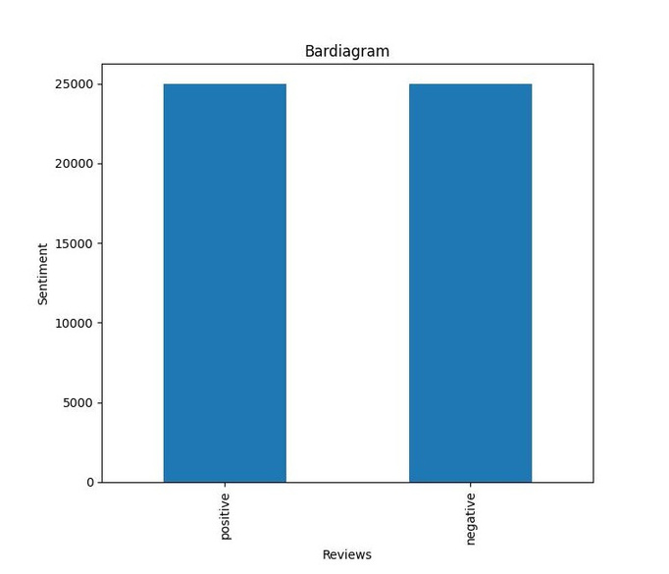
Result

Slide 8
Conclusion
In conclusion, you can predict the number of positive and negative reviews in the movie dataset using either classification or deep learning algorithms. Both approaches have their strengths and can achieve accurate results with proper tuning and preprocessing. For classification algorithms like logistic regression, decision trees, or random forests, you can start with simple feature extraction techniques like Bag-of-Words or TF-IDF and then train the model on the extracted features. These models are interpretable and can be trained quickly, making them suitable for smaller datasets. On the other hand, deep learning algorithms like neural networks, especially recurrent neural networks (RNNs) or convolutional neural networks (CNNs), can capture complex patterns in text data and potentially achieve higher accuracy. However, they require more data and computational resources for training and might be prone to overfitting if not regularized properly. Ultimately, the choice between classification algorithms and deep learning depends on factors like the size of the dataset, computational resources available, and the desired level of accuracy. Experimenting with different algorithms and preprocessing techniques is essential to find the best approach for your specific task.

Slide 9
Future scope
Enhanced Preprocessing Techniques : Develop more sophisticated text preprocessing techniques to handle challenges like handling negations, sarcasm, and context-dependent sentiment.
Advanced Feature Extraction: Explore advanced feature extraction methods such as word embeddings (e.g., Word2Vec, GloVe) or contextual embeddings (e.g., BERT, GPT) to capture richer semantic information from the text data.
Hybrid Models:Investigate hybrid models that combine the strengths of traditional machine learning algorithms with deep learning architectures to leverage their complementary features for improved performance
Fine-tuning Pre-trained Models: Fine-tune pre-trained language models (e.g., BERT, GPT) on movie review datasets to adapt them specifically for sentiment analysis tasks, potentially leading to better performance.5.
Domain Adaptation: Develop techniques for domain adaptation to improve model generalization across different genres, languages, or styles of movie reviews
Multimodal Sentiment Analysis: Extend the analysis to incorporate multimodal data sources such as movie posters, trailers, or user ratings to capture a more holistic understanding of sentiment.
Dynamic Sentiment Analysis: Explore dynamic sentiment analysis techniques that can track changes in sentiment over time, enabling applications like sentiment trend analysis or real-time sentiment monitoring during movie releases.
Interpretability and Explainability: Focus on making sentiment analysis models more interpretable and explainable, especially in critical applications like recommendation systems or content moderation.

Slide 10
References
https://www.naanmudhalvan.tn.gov.in/
https:/skillsbuild.org/
https:/www.canva.com/
https:/www.google.com
/https:/chat.openai.com/https:/www.python.org/

Slide 11
THANK YOU

